Slide 1
“Code Troopers” Sprint 3 Stakeholder Update
March 30th, 2022

Slide 2
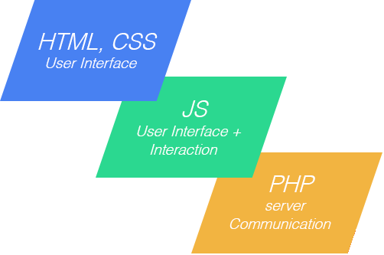

Progression of Geopop Browser
Full MVP model:
Web pages with data and user input
Front-End to Database integration and additional functionality
Country Data contained and made available to back-end

Slide 3

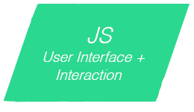


PUG and CSS (Front-End)
CSS style describing all formatting
.pug files to display all web pages and create user interactions
Dynamic content pulled on country search page (Demonstration)

Slide 4

Node.js
Connection between all program elements
Input into query conversions with a variety of options already
Framework for further functionality and implementations

Slide 5

Introducing the Database
SQL done in PHPMyAdmin
Full integration and query done through Node JS
Linked to the Front end in country.js

Slide 6

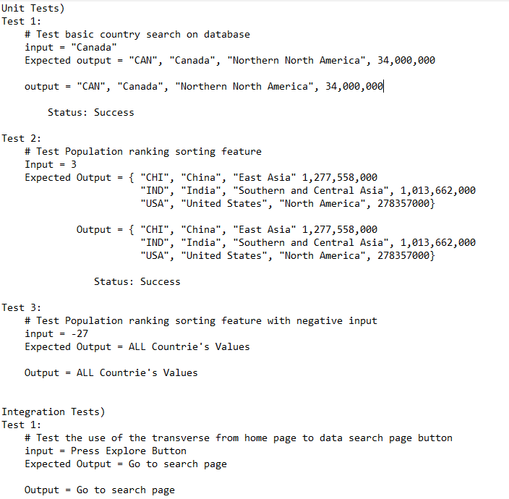
Test Case Defined
Unit tests to test all basic functionality
Integration test for only available integrated element
Lack of Automated Unit/Integration Testing

Slide 7

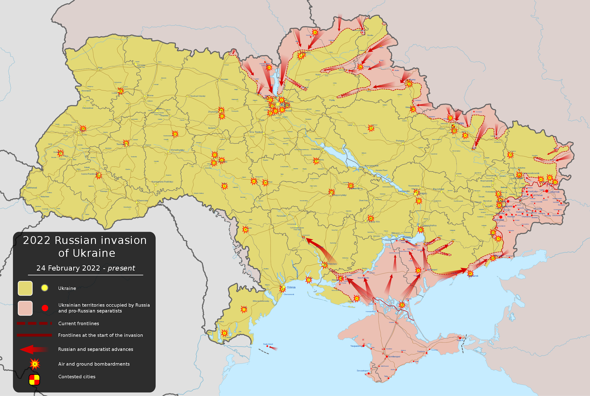
Difficulties and Delays
Testing implementation delayed
Lack of time and Unforeseen events
Good fundamentals set up in sprint 3 will guide time recuperation

Slide 8

Third Release Additional Content
Meetings log for Stakeholders
Testing Doc

Slide 9


Slides prepared by Code Troopers
Add your
Software Engineers at Kamino Softworks who work to change the world and improve the lives of people around the globe. Graduates from Roehampton in 2023 with a degrees in Computer Science. Love to work improving the future with a diverse and dedicated staff.
Code Troopers make no claim to ownership of Media images in this powerpoint. Images taken from Google.

